Slide 1
Computer Networking
CDN, Video Streaming

Slide 2
This lecture
Content Delivery Networks (CDN)
Internet video streaming

Slide 3
Readings
The Akamai Network: A Platform for High-Performance Internet Applications
Improving fairness, efficiency, and stability in HTTP-based adaptive video streaming with FESTIVE

Slide 4
CDN

Slide 5
Overview
CDN architecture
DNS-based redirection
EDNS

Slide 6
HTTP (Quick review)
Stateless request/response protocol
Completely TCP-based
Fetching URL: www.mnit.ac.in/index.html
Resolve DNS of www.mnit.ac
Setup TCP
Send HTTP request: GET /index.html
Wait for HTTP response, execute embedded code
Most content is cacheable (for some TTL)
Dynamic content, Live videos, etc are not cacheable

Slide 7
Background: Web
More popular contents, websites
Client-to-Client ➔ Server-to-Client
Content providers: Vested interest in performance, reliability, scalability
ISPs: Dramatic increase of peering traffic
Notes:
The motivation of CDN is very similar to that of CCN and other data-oriented systems.
Starting from the 90s, there is a huge change in traffic pattern: the web became very popular, and that changes fundam
The service model also changed from XXX to XXX
Vested interest…
For instance, a one-hour outage could cost one well-known, large online retailer $2.8 million in sales, based on 2009 revenue numbers.

Slide 8
Key Characteristics of Web Traffic
K-th item popularity = 1/k
# of appearance
Zipf or power law on both content popularity & access ISP population
Rank of content/ISP
Two implications:
Skewness: Popular content need to be optimized.
Long tail: Improving a few top ISPs is not enough.
Notes:
Now, let’s take a closer look at the implications of these trends.

Slide 9
Why Not Single Server?
Client
Internet
Server
Poor performance/reliability/scalability:
Single point of failure
Easy to be overloaded
Long latency
Suboptimal WAN (BGP) performance
Huge peering traffic!

Slide 10
Why Not ISP Proxy Caching?
Access ISP
Internet
Client
Server
Proxy
Cache HTTP responses
Pros:
Reduced RTT of cached content
Reduced peering traffic & server load
Cons:
Security/authentication
Content providers want fine-grained control on when/where to cache its content
Cold start

Slide 11
CDN Architecture
Internet
Origin server
EU Clients
CDN
Edge servers
CDNs
Content providers contract with CDNs
Better coordination across replicas (controlled content refresh/removal)
Proactive content replication on many edge servers
Win-win for ISPs and content providers
Asia
Notes:
CDN addresses all these issues, by building a coordinated global infrastructure of caches in almost all edge ISPs.
It addresses the security/authentication issues by contracting directly with content providers.
It addresses the fine-grained control over when/where the content is cached since it can dynamically XXX
It addresses the cold-start problem by proactively replicating content on many edge serves
Finally, it is a win-win solution for both ISPs and CP

Slide 12
CDN Challenges & Design Space
Internet
Origin server
EU Clients
CDN
How/where to replicate content?
Edge servers
How to direct client towards replica?
Asia

Slide 13
Case Study: Akamai
Distributed servers
60,000~ servers
1,000~ networks
70~ countries
Client requests
10^8~ requests per day
20% web, majority video
Major customers
BBC, FOX, Apple, NBC, Facebook, Vevo, NFL, etc

Slide 14
Design Choices of Akamai (1)
Internet
Origin server
EU Clients
CDN
How/where to replicate content?
High performance, fault tolerance
Edge servers
Multipath overlay routing to reduce loss
Recover packet losses by redundancy
Two-layer cache structure
Cache miss handled by an intermediate layer
Consistent hashing for replica placement
Replace < N/k items when one server is down.
Asia

Slide 15
Design Choices of Akamai (2)
Internet
Origin server
EU Clients
CDN
Edge servers
How to find replicated content?
Mapping system
Asia

Slide 16
Mapping System
Map a client IP to a server
Pick server of the best performance
Equivalence classes of IP addresses
IP addresses experiencing similar performance
Data-Driven: Collect and combine measurements
Traceroute, BGP feeds, server logs
Latency, loss rate, cluster health
Big data: 100 TB per day, update every minute
Notes:
The basic function of mapping system is to map XXX
There are two key ideas:
XXX
XXX

Slide 17
Mapping System
Client ➔ Cluster
Based on client-to-cluster performance
Updated every minute
Cluster ➔ Server
Load balancing
Maximizes cache hit rate (hashing)
Notes:
Mapping system uses two steps to map a client to a server

Slide 18
Design Choices of Akamai (2)
Internet
Origin server
EU Clients
CDN
Edge servers
How to direct client towards a replica?
HTTP redirection (rewriting URL)
No redirection transparency
Anycast
No direct control on replica selection
DNS-based redirection
Asia

Slide 19
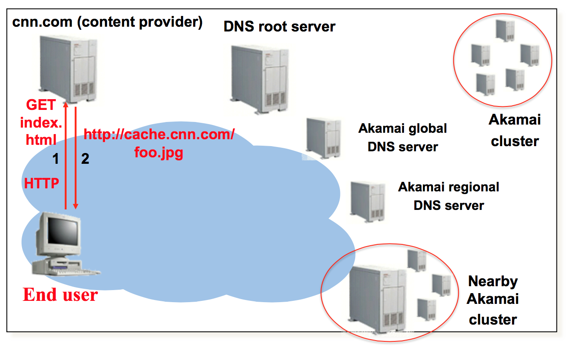
DNS-based Redirection
Source: Jannifer Rexford (http://www.cs.princeton.edu/courses/archive/spr12/cos461/)

Slide 20
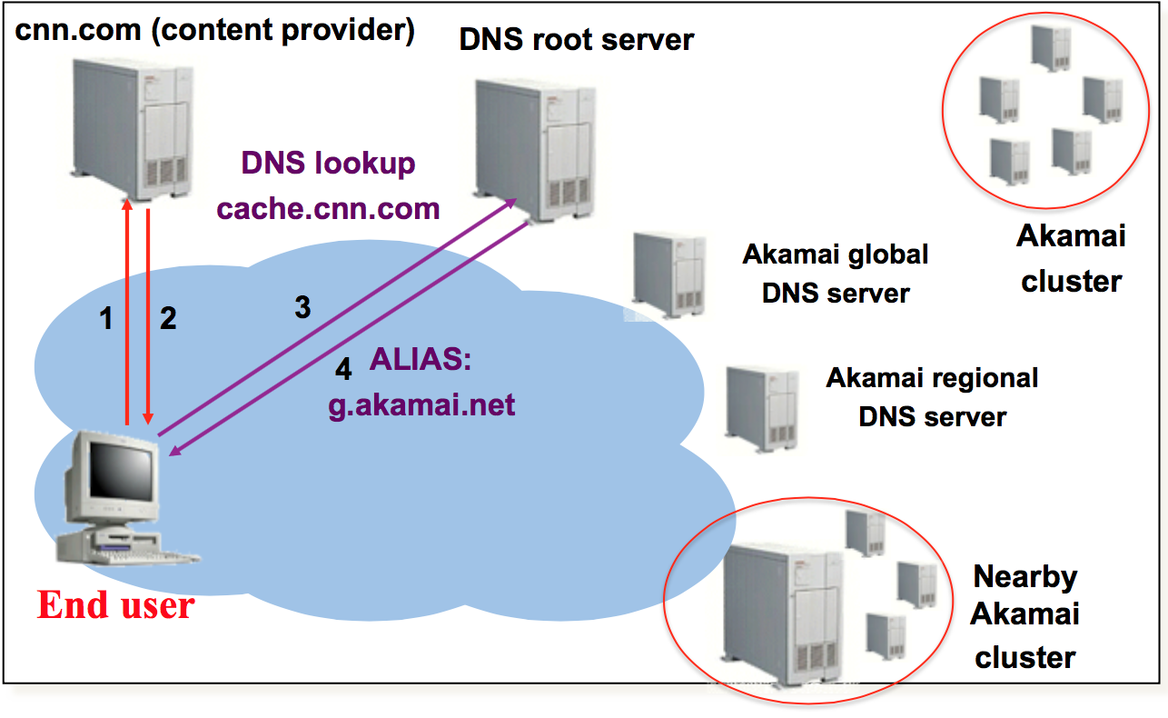
DNS-based Redirection
Source: Jannifer Rexford (http://www.cs.princeton.edu/courses/archive/spr12/cos461/)

Slide 21
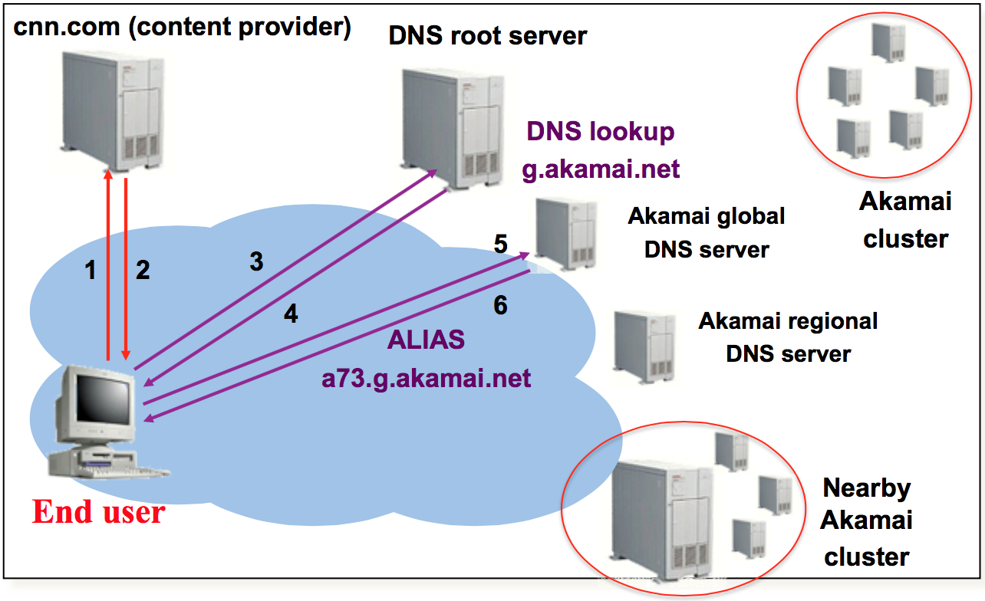
DNS-based Redirection
Source: Jannifer Rexford (http://www.cs.princeton.edu/courses/archive/spr12/cos461/)

Slide 22
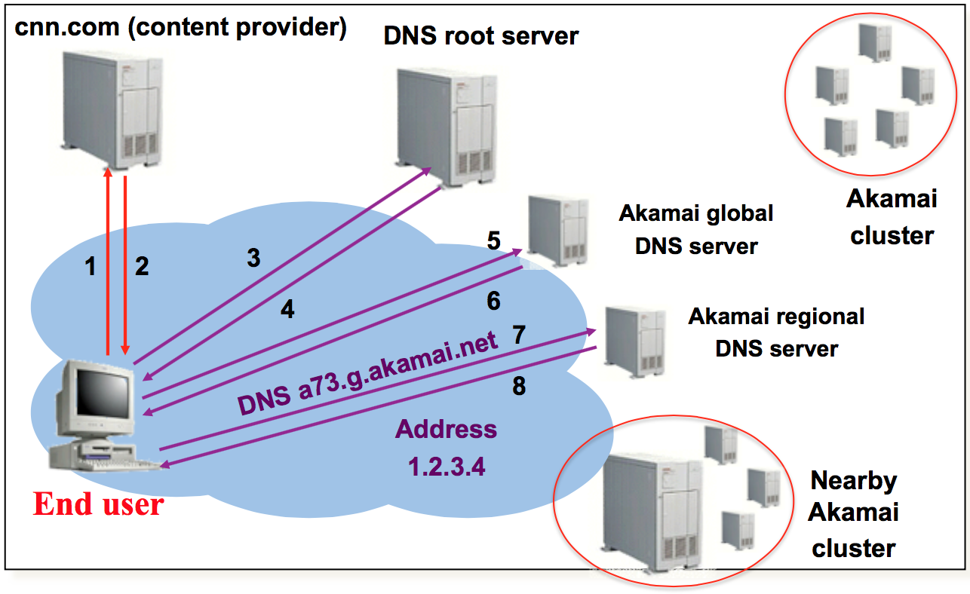
DNS-based Redirection
Source: Jannifer Rexford (http://www.cs.princeton.edu/courses/archive/spr12/cos461/)

Slide 23
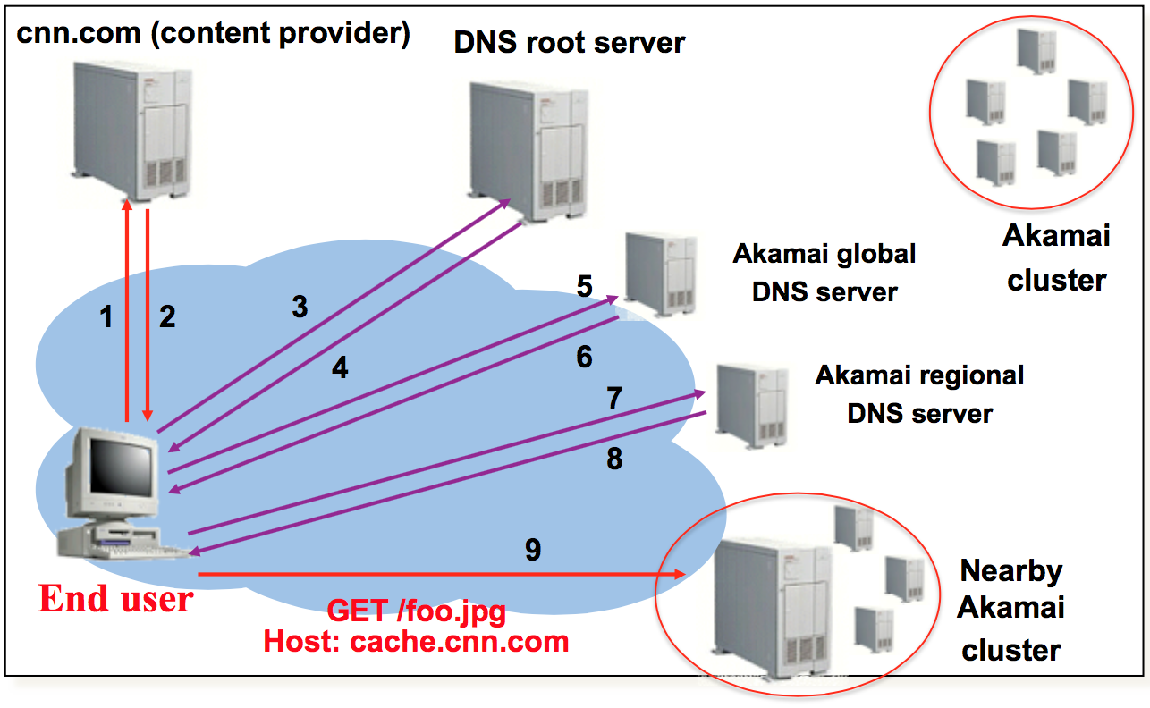
DNS-based Redirection
Source: Jannifer Rexford (http://www.cs.princeton.edu/courses/archive/spr12/cos461/)

Slide 24
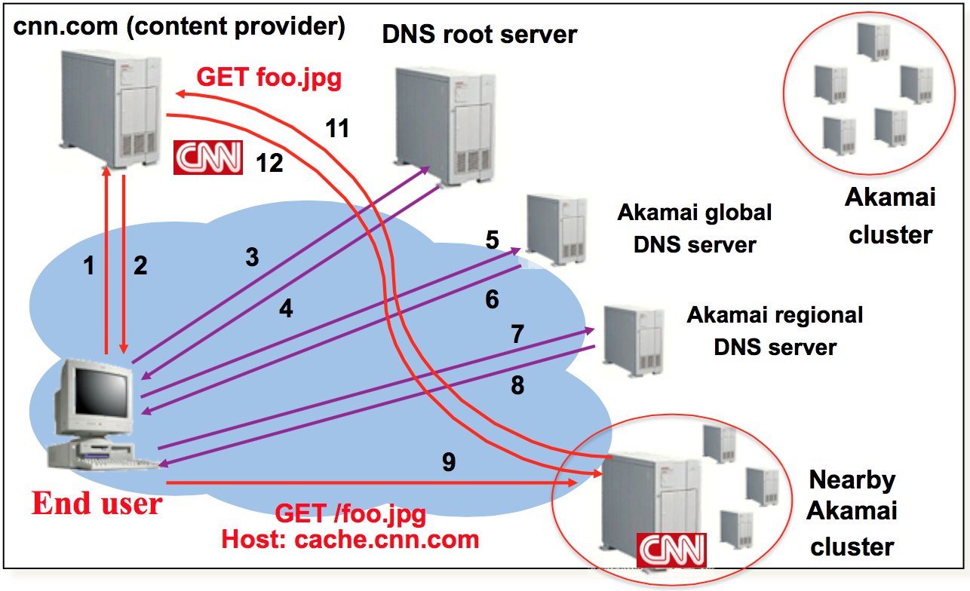
DNS-based Redirection
Source: Jannifer Rexford (http://www.cs.princeton.edu/courses/archive/spr12/cos461/)

Slide 25
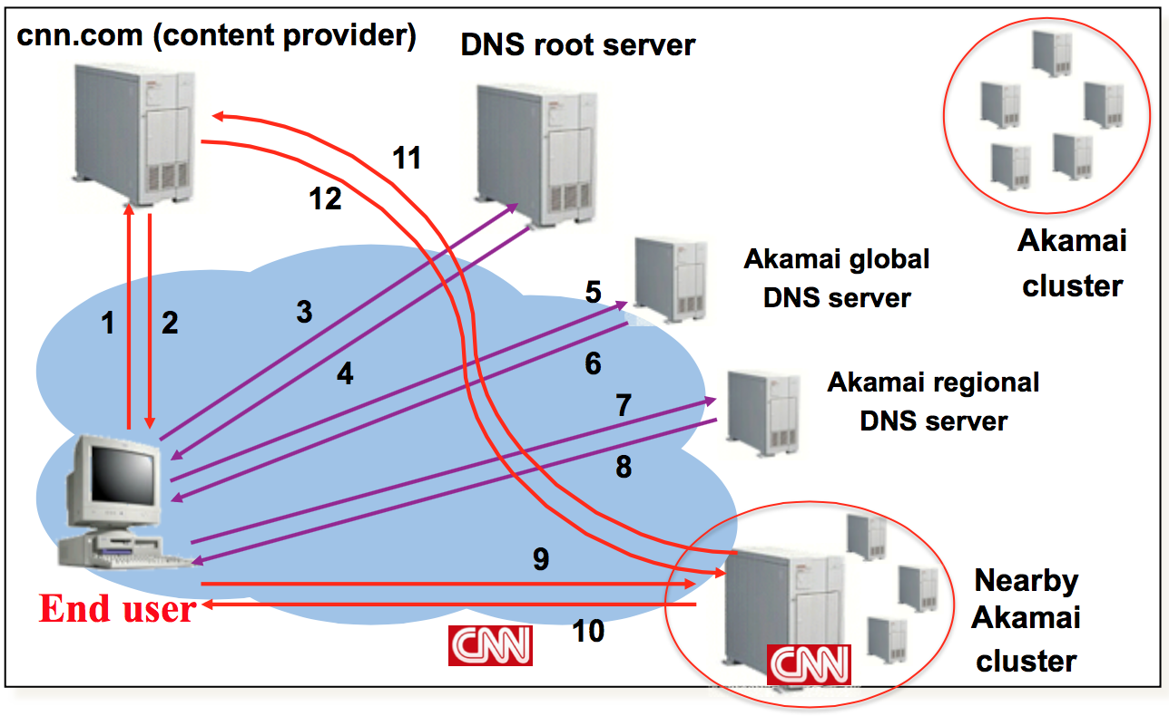
DNS-based Redirection
Source: Jannifer Rexford (http://www.cs.princeton.edu/courses/archive/spr12/cos461/)

Slide 26
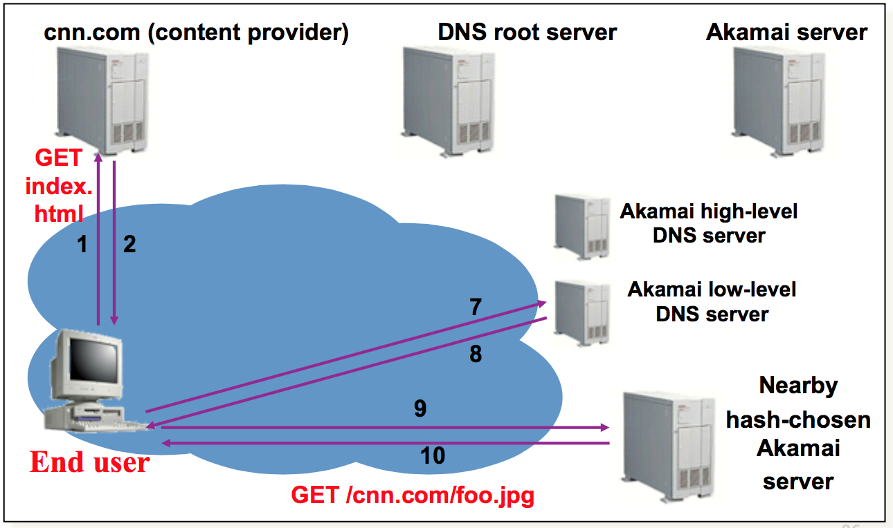
Subsequent Requests
Source: Jannifer Rexford (http://www.cs.princeton.edu/courses/archive/spr12/cos461/)

Slide 27
Tradeoff: Anycast vs. DNS-based
Internet
Origin server
EU Clients
CDN
Edge servers
DNS-based redirection vs. Anycast
Anycast: Simplicity, reduce latency (less DNS lookup)
DNS-based redirection: Fine-grained server selection
Asia

Slide 28
EDNS
Notes:
Finally, EDNS

Slide 29
Problem of DNS-based Redirection?
Third-party DNS resolvers become popular
OpenDNS, Google DNS
Better security (firewalls), less maintenance cost
Third-party DNS totally breaks the assumption of DNS-based redirection
Notes:
Finally, let’s introduce a recent trend in DNS techniques, called EDNS
The motivation is the recent emergence of third-party DNS resolvers totally breaks the DNS-based redirection.

Slide 30
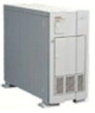
Problem of DNS-based Redirection
Picks servers near DNS resolver
Third-party DNS resolver
DNS server no longer in client’s domain.
CDN DNS server don’t see client’s IP.
Source: Jannifer Rexford (http://www.cs.princeton.edu/courses/archive/spr12/cos461/)

Slide 31
Problem of DNS-based Redirection
Picked servers = F(DNS resolver)
Google DNS, Open DNS
EDNS: include client IP prefix in DNS requests
DNS server no longer in client’s domain.
CDN DNS server don’t see client’s IP.
Source: Jannifer Rexford (http://www.cs.princeton.edu/courses/archive/spr12/cos461/)

Slide 32
Benefit of EDNS
Picked servers = F(Client IP)
DNS resolver
Why is Akamai lukewarm about switching to EDNS?

Slide 33
Video Streaming
Slides: Matthew Mukerjee, Hui Zhang

Slide 34
Overview
Background/Terminology
Client-server protocol: HTTP chunking
Video quality analytics

Slide 35
The Internet Today…
Video
Video
Could be Video
Probably Video
It’s all Video!
Encrypted Video?
Purchasing Videos?
DEFINITELY Video!
Sharing Video!
Video in the name!
Ads! (and Videos!)
2014 1H – NA Fixed Access
Notes:
Why do we care about video?

Slide 36


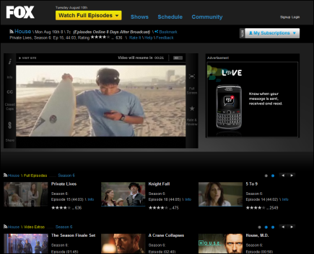
Demystifying Video Delivery
Video Source
Screen
Video Player
???
What’s this?
Today’s lecture
Internet
Source: www.conviva.com
Notes:
So how video is delivered today?

Slide 37
Terminology
Frame
FPS (frames per second)
24, 25, 30, or 60
Resolution
Number of pixels per frame
160x120 to 1920x1080 (1080p) to 4096x2160 (4K)
Bitrate
Information stored/transmitted per unit time
Usually measured in kbps to mbps
Ranges from 200Kbps to 30 Mbps

Slide 38
Requirements
What’s video quality?
Smooth/continuous playback
High bitrate
Short start-up time
What they mean depends on the type of videos
 | Delay | Bandwidth | Examples
2, N-way conference | < 200 ms | 4 kbps audio only, 200 kbps – 5 Mbps video | Skype, Google hangout, Polycom, Cisco
Short form VoD | < 1-5s | 300 kbps – 2 Mbps & higher | Youtube
Long form VoD | < 5-30s | 500 kbps – 6 Mbps & higher | Netflix, Hulu, Qiyi, HBOGO
Live Broadcast | < 5-10s | 500 kbps – 6 Mbps & higher | WatchESPN, MLB

Slide 39
Client-Server Protocol
Video Source
Screen
Video Player
???
What protocol?
Internet
Source: www.conviva.com

Slide 40
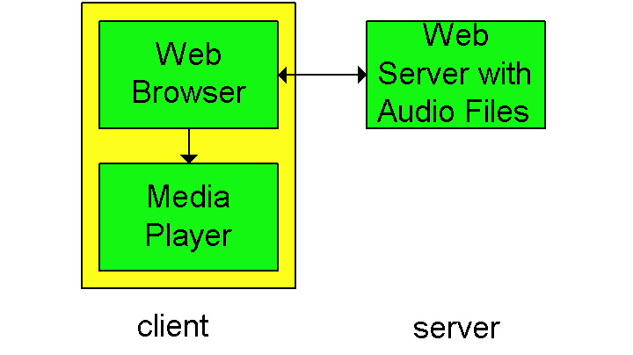
1st Gen: HTTP Download
Browser requests the video (file), stores it locally, and gives the file to the player to display.

Slide 41
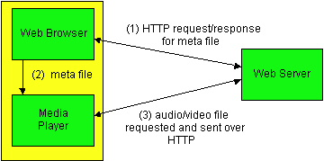
First Gen: HTTP Progressive Download (2)
Alternative: set up connection between server and player; player takes over
Web browser requests and receives a Meta File (which describes the object) instead of receiving the file itself;
Browser launches the player and passes it the Meta File;
Player sets up a connection with Web Server and downloads or streams the file by HTTP

Slide 42
Streaming Model: Buffers and Timing
Max Buffer Duration
= allowable jitter
File Position
"Bad": Buffer overflows
Smooth Playback Time
Max Buffer Size
Buffer Duration
"Bad": Buffer underflows and playback stops
Buffer Size
"Good" Region: smooth playback
Buffer almost empty
Time

Slide 43
Drawbacks of HTTP Progressive Download
HTTP connection keeps data flowing as fast as possible to user's local buffer
May waste bandwidth if user does not watch the entire video
TCP file transfer can use more bandwidth than necessary
Cannot change video quality (bit rate) to adapt to network congestion
Mismatch between whole file transfer and stop/start/seek playback controls.
However: player can use file range requests to seek to video position
Takeaways of 1st generation: General-purpose protocols don’t work

Slide 44
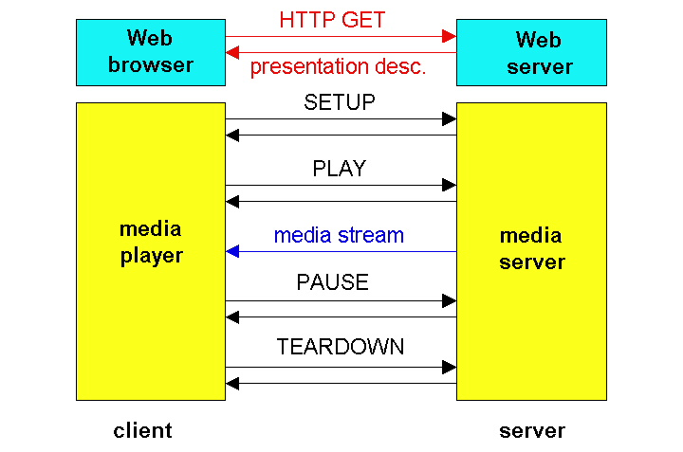
2nd Generation: Real-Time Streaming
Build our own protocol! This gets us around HTTP; app layer protocol can be better tailored to Streaming
Example: Real-time Streaming Protocol

Slide 45
Example: Real Time Streaming Protocol (RTSP)

Slide 46
Drawbacks of Real-Time Streaming
Per-client state!
Streaming protocols often blocked by routers
HTTP delivery can use ordinary proxies and caches
Takeaways of 1st & 2nd generations:
1st gen: General-purpose protocols (HTTP) don’t work
2nd gen: Rather than adapt Internet to streaming, adapt media delivery to the Internet

Slide 47
3rd Generation: HTTP Streaming
Reusing HTTP: Client-centric architecture with stateful client and stateless server
Standard server: Web servers
Standard Protocol: HTTP
Session state and logic maintained at client
HTTP Chunking: Video is broken into multiple chunks (like with bittorrent)
Each chunk can be played independent of other chunks
Playing chunks in sequence gives seamless video
Meta-file (manifest) provides chunk file names

Slide 48
HTTP Chunking Protocol
Manifest:
A1, A2, …
Server
Client
Manifest
HTTP Adaptive Player
A1
A2
…
…
A1
A1
A2
Manifest
HTTP GET Manifest
Cache
Web browser
Web server
Web server
HTTP
HTTP
TCP
TCP

Slide 49
HTTP Chunking Protocol
Manifest:
A1, A2, …
Server
Client
Manifest
HTTP Adaptive Player
A1
A2
…
…
A1
A1
A2
A1
A2
HTTP GET A1
HTTP GET A2
Cache
Web browser
Web server
Web server
HTTP
HTTP
TCP
TCP

Slide 50
Adaptive Bitrate with HTTP Streaming
Encode video at different quality/bitrate levels
Client can adapt by requesting chunks at different bitrate levels
Chunks of different bitrates must be synchronized
All encodings have the same chunk boundaries and all chunks can be played independently, so you can make smooth splices to chunks of higher or lower bit rates

Slide 51
HTTP Chunking Protocol
Manifest:
LQ: A1, A2, …
HQ: B1, B2, ...
Server
Client
Manifest
HTTP Adaptive Player
B1
A1
A2
…
…
A1
A1
A1
A2
B1
B2
…
…
HTTP GET A1
B2
HTTP GET B2
Cache
B1
B2
Web browser
Web server
Web server
HTTP
HTTP
TCP
TCP

Slide 52
Advantages of HTTP Streaming
Easy to deploy: it's just HTTP!
Work with existing caches/proxies/Webservers/Firewall
Fast startup by downloading lowest quality/smallest chunk
Bitrate switching is seamless
Can switch bitrate and server (even CDN) during playback
Tradeoff 1: fixed chunk length.
Small with respect to the movie size
Large with respect to TCP
5-10 seconds of 1Mbps – 3Mbps → 0.5MB – 4MB per chunk
Tradeoff 2: predetermined bitrate levels
Can only switch between predetermined bitrate levels.

Slide 53
Demystifying Video Delivery
Video Source
Screen
Video Player
???
Internet
Source: www.conviva.com

Slide 54

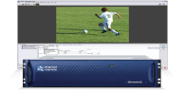
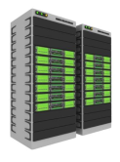
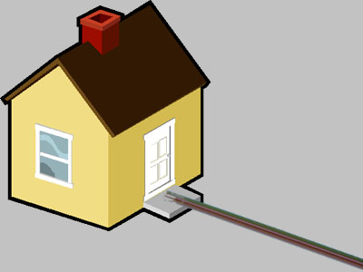
Demystifying Video Delivery
Video Source
Screen
Video Player
Encoders & Video Servers
ISP & Home Net
CMS and Hosting
???
Internet
Source: www.conviva.com
Notes:
We know that video streaming uses
Content Management System

Slide 55

Demystifying Video Delivery
Video Source
Screen
Video Player
Encoders & Video Servers
Content Delivery Networks (CDN)
ISP & Home Net
CMS and Hosting
Source: www.conviva.com

Slide 56
Overview
Background/Terminology
Client-server protocol: HTTP chunking
Video quality analytics

Slide 57
What’s wrong with this picture?
Video Source
Screen
No Feedback!
Video Player
Encoders & Video Servers
ISP & Home Net
CMS and Hosting
Content Delivery Networks (CDN)
Source: www.conviva.com

Slide 58
Closing the Loop with Quality Analytics
Video Source
Content Broker
Screen
Video Player
Encoders & Video Servers
Why feedback from clients?
- Only client can measure video quality accurately
ISP & Home Net
CMS and Hosting
Content Delivery Networks (CDN)
Source: www.conviva.com

Slide 59

Closing the Loop with Quality Analytics
Video Source
Screen
Video Player
Encoders & Video Servers
ISP & Home Net
CMS and Hosting
Content Delivery Networks (CDN)
Source: www.conviva.com

Slide 60
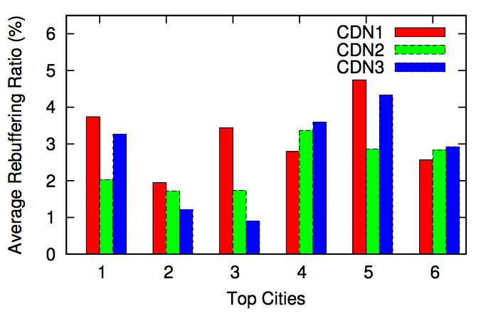
Why Quality Analytics is Challenging? (1) Spatial Diversity of Performance
Performance of CDNs have large spatial diversity.
Need to choose CDN (servers) for different clients.

Slide 61
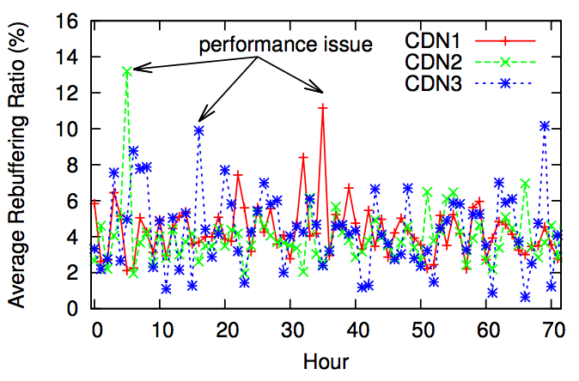
Why Quality Analytics is Challenging? (2) Temporal Diversity of Performance
Performance of CDNs have large temporal variance.
Need to choose CDN (servers) dynamically.

Slide 62
Conviva Architecture
How to scale up?
C3: Internet-Scale Control Platform for Video QoE Optimization

Slide 63
Next Lecture
Wireless

Slide 64
Discussion
Centralized (Level3, Limelight) vs. Decentralized (Akamai)
A few well-connected clusters vs. More edge clusters
Low maintenance cost vs. Better performance
Difference between CDN and Cloud
Content delivery (caching) vs. computation
More locations vs. few locations with beefy machines
How to handle video streaming?
Since caching saves traffic for ISPs, should CDN charge ISPs?

Slide 65
DNS Message Format
Identification
Flags
12 bytes
No. of Questions
No. of Answer RRs
No. of Authority RRs
No. of Additional RRs
Name, type fields for a query
Questions (variable number of answers)
Client IP prefix is included here
No change on the format
Backward compatibility
RRs in response to query
Answers (variable number of resource records)
Records for authoritative servers
Authority (variable number of resource records)
Additional Info (variable number of resource records)
Additional “helpful info that may be used

Slide 66
Example of EDNS

Slide 67
Demystifying Video Delivery
Video Source
Screen
Video Player
Encoders & Video Servers
ISP & Home Net
CMS and Hosting
Content Delivery Networks (CDN)
Notes:
Content Management System

